Slide 1

STROKE
PREDICTION
Prepared by :
Samiyah Ali Alshehri

Slide 2
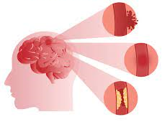
Overview ..
Introduction.
Data Cleaning.
Exploratory Data Analysis .
Visualization.
prepressing.
modeling.

Slide 3
INTRODUCTION
A stroke occurs when the blood supply to part of your brain is interrupted or reduced, preventing brain tissue from getting oxygen and nutrients.
objective is to understand what are the reasons that cause stroke to peoeple ?

Slide 4


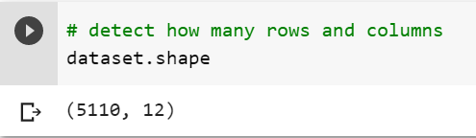
Dataset ..
FROM
5110 Observations
12 features

Slide 5

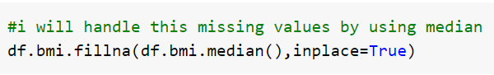
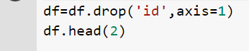
Data Cleaning ..
handle the null value
Drop ID column

Slide 6
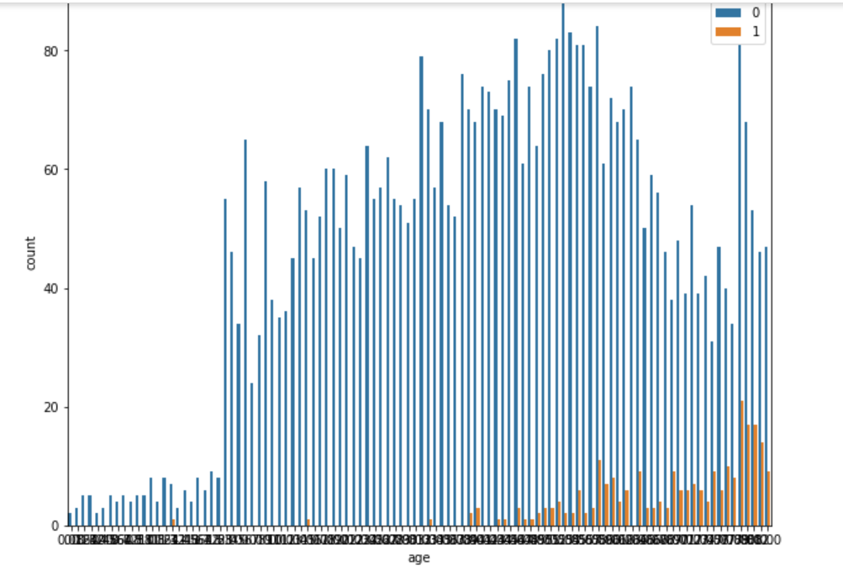
Exploratory Data Analysis (EDA)
How does age affect stroke risk?
From age features it can be seen that old age people are mostly having strokes, compared to younger ones.

Slide 7
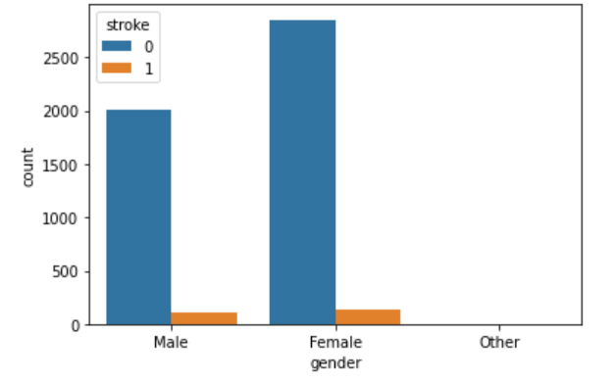
Exploratory Data Analysis (EDA)
which gender is the most infection to stroke?
From gender features it can be
seen that men people are mostly having strokes, compared to female ones.

Slide 8
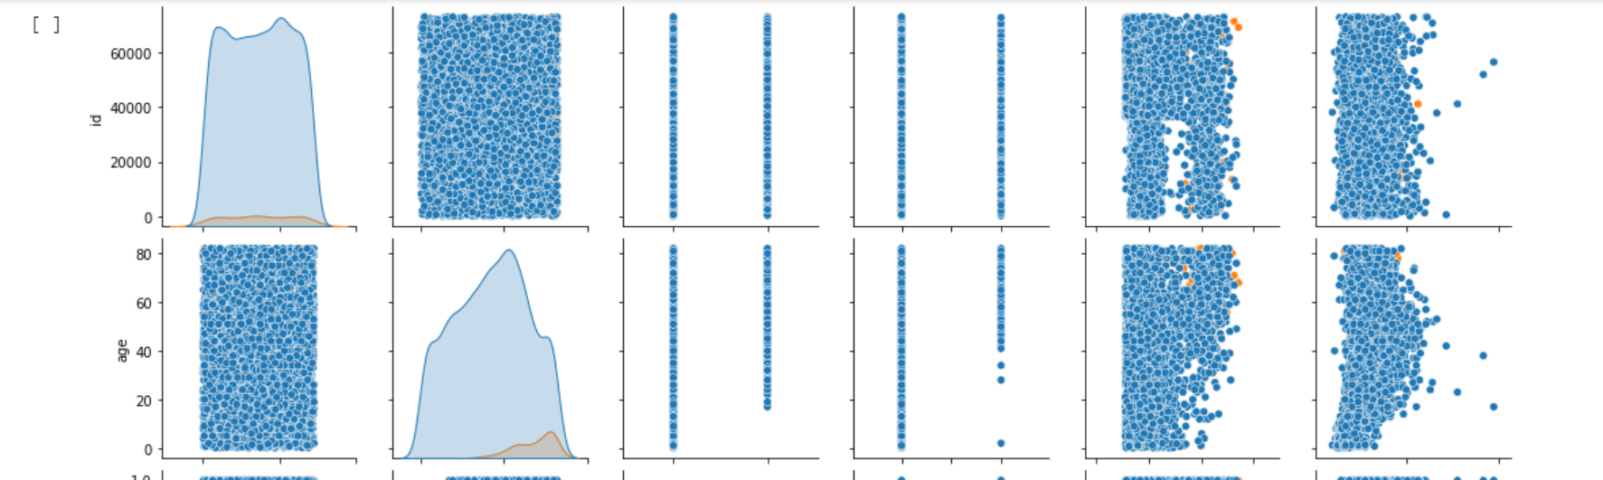

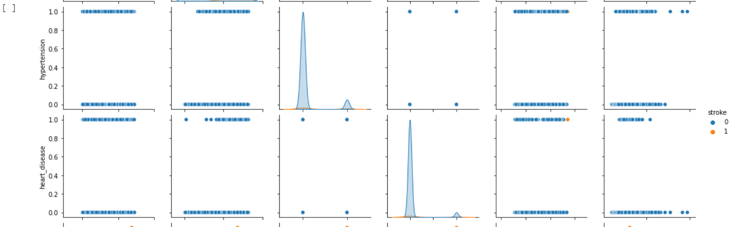
Exploratory Data Analysis (EDA)

Slide 9

treatment imbalance
label encoder
OneHot
encoding
Prepressing ..

Slide 10

Classification models
KNN
0.80
RF
0.89
LR
0.78
logistic regression
algorithm
k-nearest neighbors
algorithm
Random Forest Classifier

Slide 11

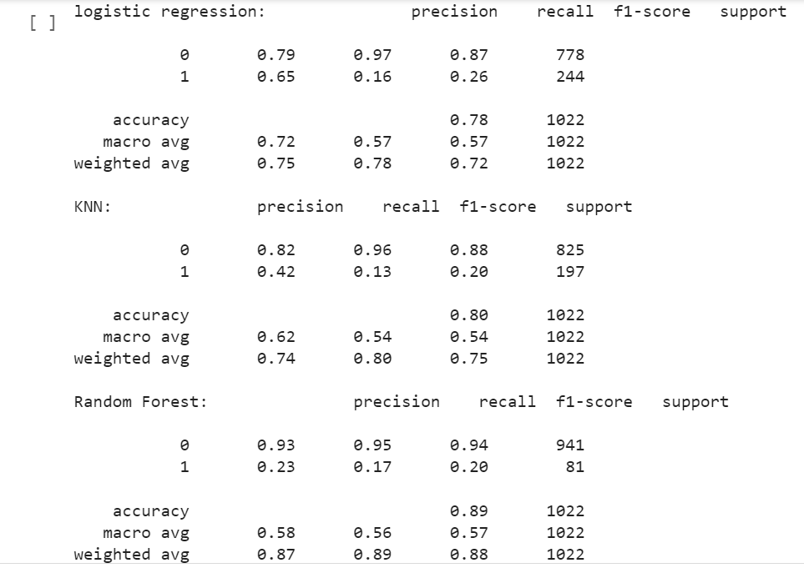

Classification models ..

Slide 12

Tools ..
Pandas
NumPy
Matplotlib
Scikit-learn
Seaborn

Slide 13
Thank you all
Any Questions ?

